Slide 1
NEuroevolution through Augmented Topologies (NEAT) for Snake Game
David Guszejnov

Slide 2
NEAT for SNAKE
Idea: Train a computer to play Snake
Challenges:
Stochastic game (position of new food is random)
Neural network must use stochastic strategy
Too many inputs slow down learning
Instead of giving every pixel as input make the snake shortsighted
How should fitness be determined?
Give small reward for surviving and large reward for eating food

Slide 3
Shortsighted Snake Inputs and Outputs
Outputs:
1
2
3
UP
4
5
LEFT
RIGHT
6
7
8
DOWN

Slide 4
Generation 1
1
Left
40%
2
3
Right
20%
4
5
Up
20%
6
7
Down
20%
8
Bias

Slide 5
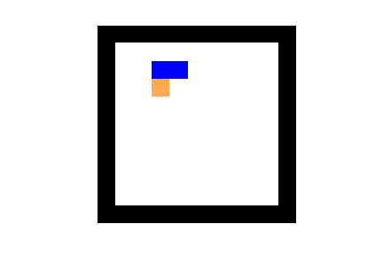
Generation 1
Network “Smartness”: Has no idea what it is doing!
Hits wall!

Slide 6
Generation 40
1
Left
2
3
H1
Right
4
5
Up
H2
6
7
Down
8
Bias

Slide 7
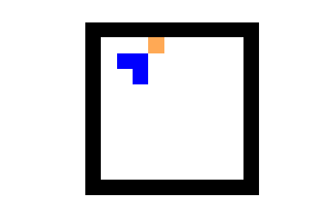
Generation 40
Network “Smartness”: Avoids wall, does loop
Does not look for food!

Slide 8
Generation 100
1
Left
Left
2
H1
3
H1
Right
Right
4
5
Up
Up
H2
H2
6
6
7
7
Down
Down
8
8
Bias
Bias

Slide 9
Generation 100
1
Left
Left
2
H1
3
H1
Right
Right
4
5
Up
Up
H2
H2
6
6
7
7
Down
Down
8
8
Bias
Bias

Slide 10
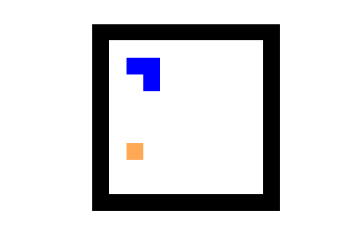
Generation 100
Network “Smartness”: Avoids walls
Explores, looks for food
Shortsighted, may entrap itself!

Slide 11
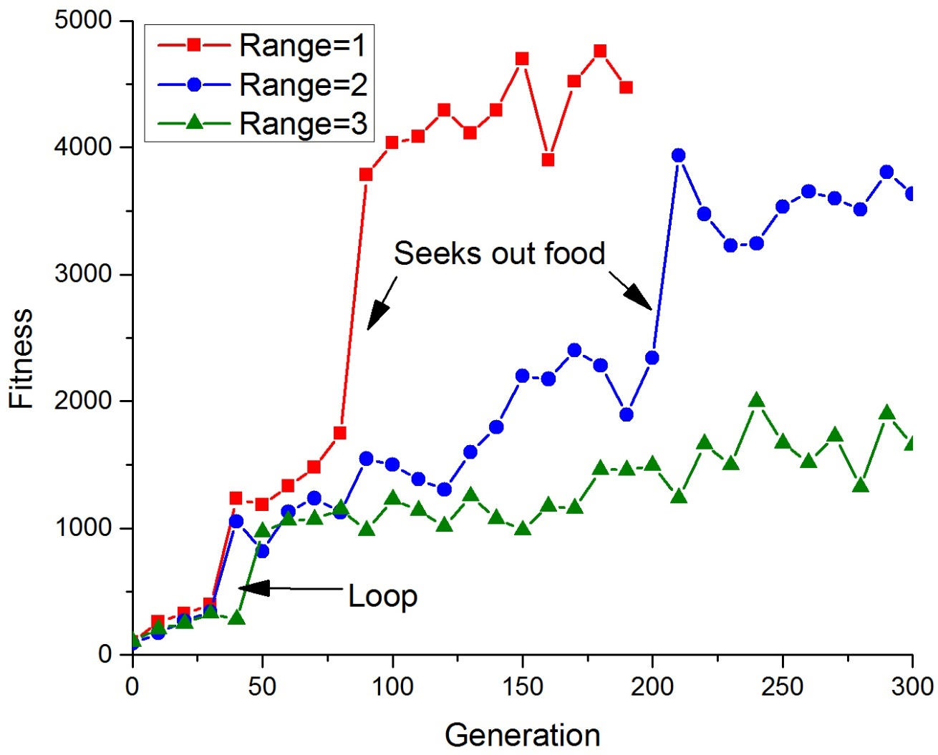
Evolution of Population Fitness

Slide 12
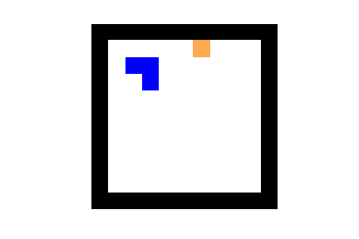
Sight Range=2
Network “Smartness”: Avoids walls
Explores, looks for food
Uses “folding” strategy for long snake
Shortsighted

